Slide 1
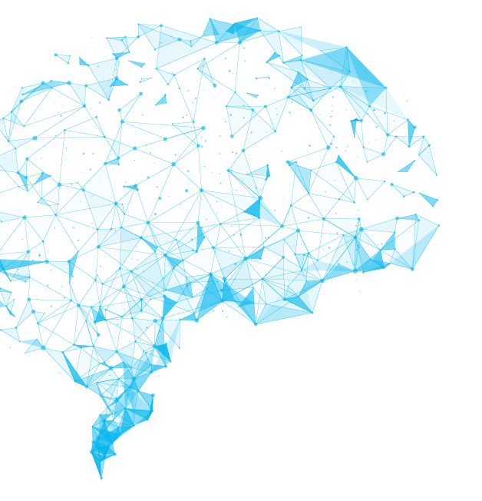
Altar Tosun
University of Kassel
Variational Autoencoders
and
Generative Adversarial Networks
Generative Deep Learning Algorithms in Comparison

Slide 2
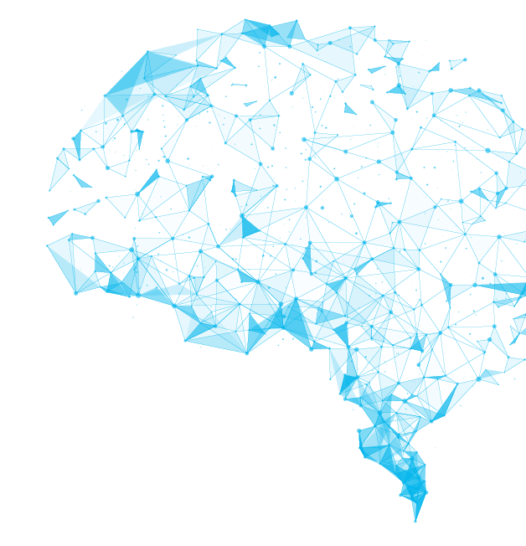
What is Generative Model ?
Informally:
Generative models can generate new data distances.
Formally:
Generative models capture the joint probability p(x, y), or just p(x) if there are no labels.
Two of the most used and efficient approaches are
Generative Adversarial Networks (GAN) and Variational Autoencoders (VAE).
1

Slide 3

1 - Generative Adversarial Networks
GANs were introduced in 2014 by J. Goodfellow and co-authors.
Contains two sub-models: the generator model that we train to generate new examples, and the discriminator model that tries to classify examples as either real or fake.
These two models are trained together , adversarial, until the discriminator is fooled.
GANs is the most interesting idea in the last ten years in machine learning.
Yann LeCun
2

Slide 4
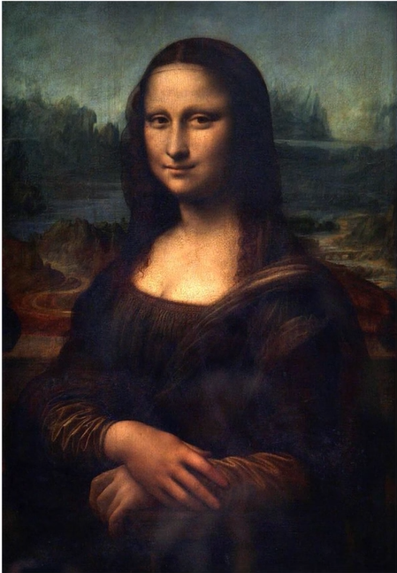
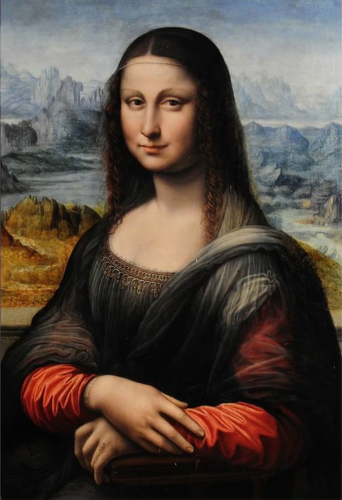

How the GANs Work ?
Leonardo DaVinci
Forger
Researcher
3

Slide 5
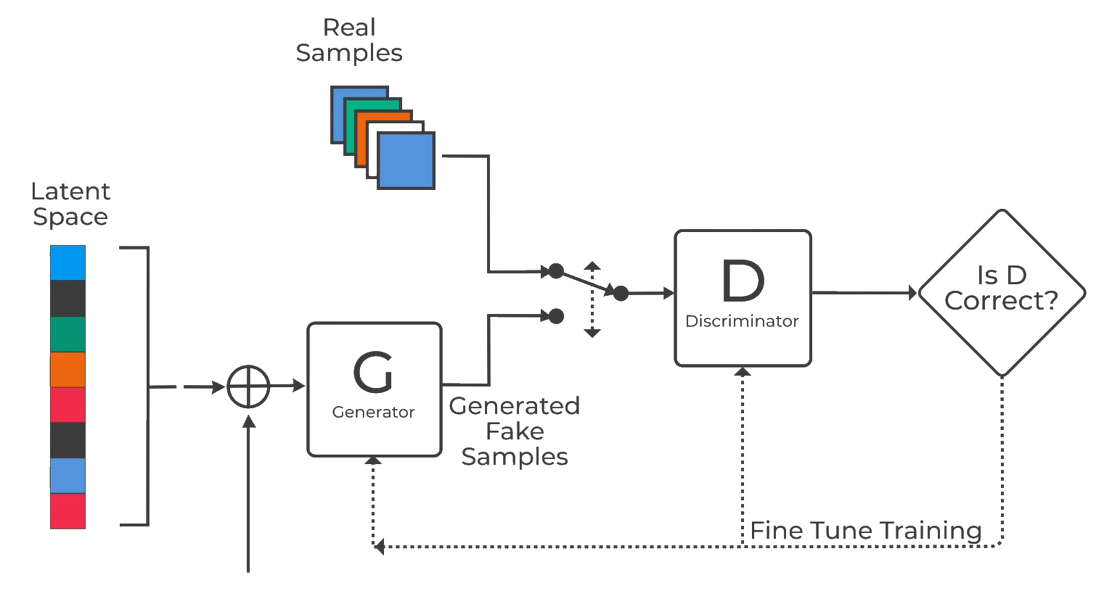
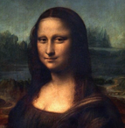
Forger
Noise
4

Slide 6
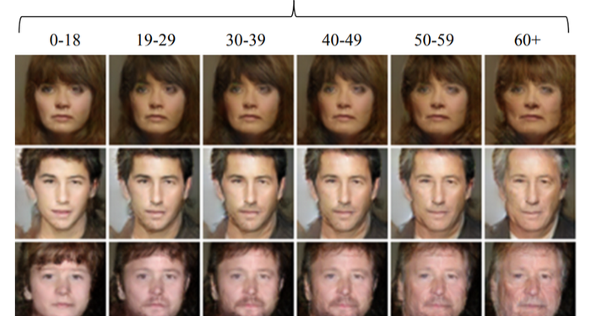
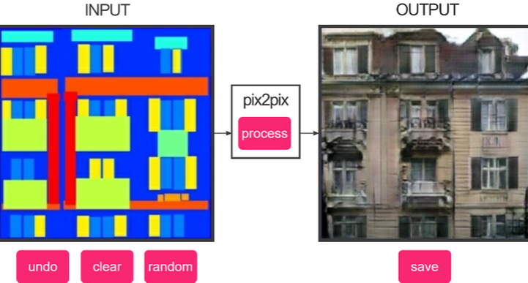
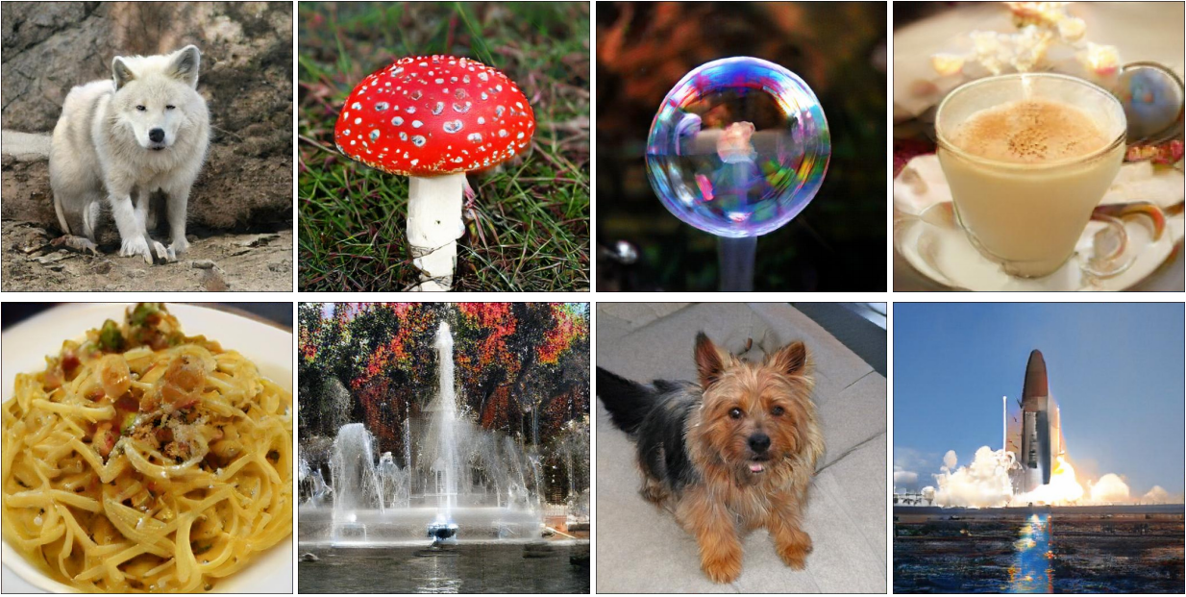
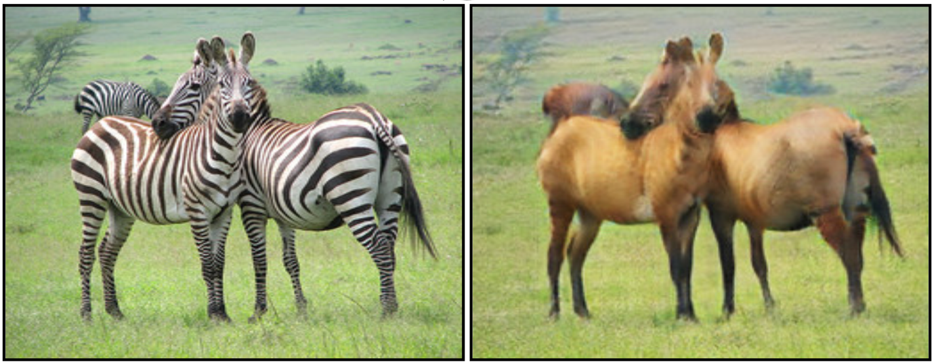
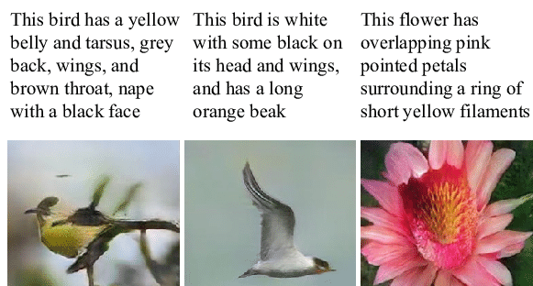
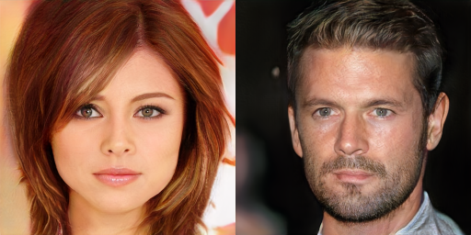
GANs in Application
Age-cGAN
Pix2Pix
BigGAN
CycleGAN
StackGAN
StyleGAN

Slide 7
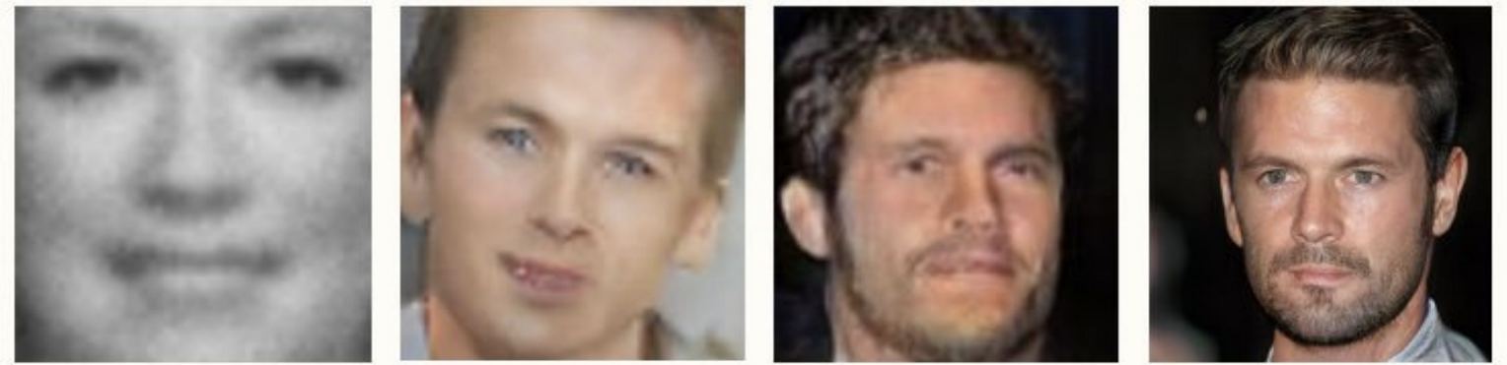
Evolution of GANs
GENERATING FACES
2014
2015
2016
2017
6

Slide 8
2 - Variational Autoencoders
VAEs were introduced in 2013 by Diederik P. Kingma and Max Welling.
VAE consists of two parts: an encoder and a decoder. The encoder takes an input sample and converts its information into vector. The decoder takes the vector and expands it out to reconstruct the input sample.
VAEs work with remarkably diverse types of data, sequential or non-sequential, continuous or discrete, even labeled or completely unlabeled, making them powerful generative tools.
7

Slide 9
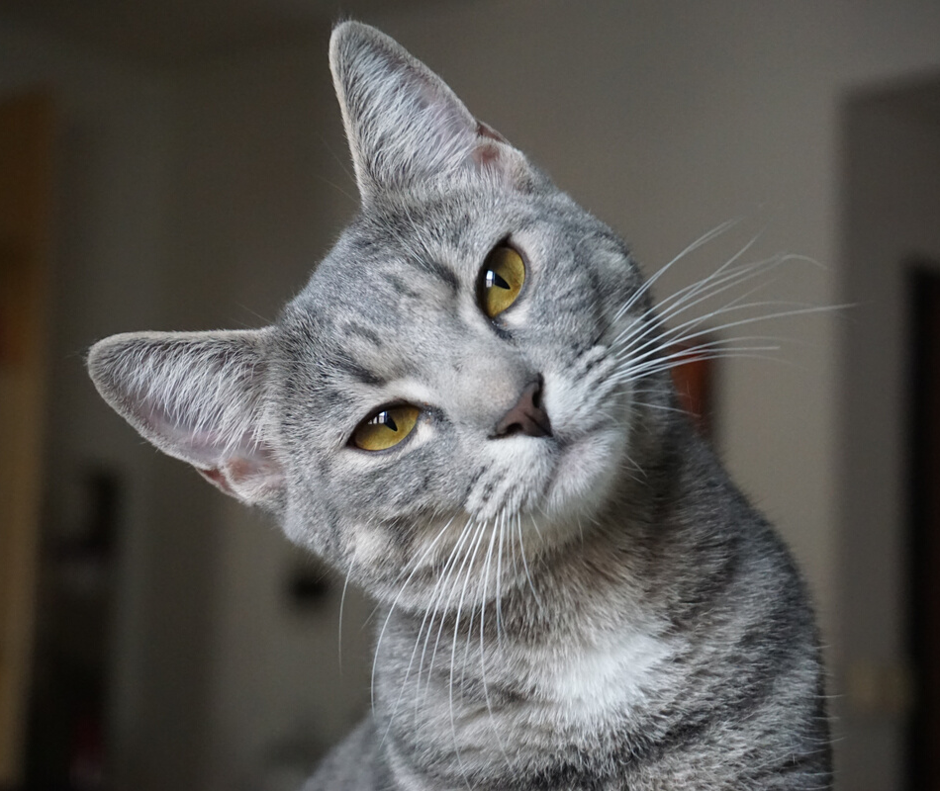
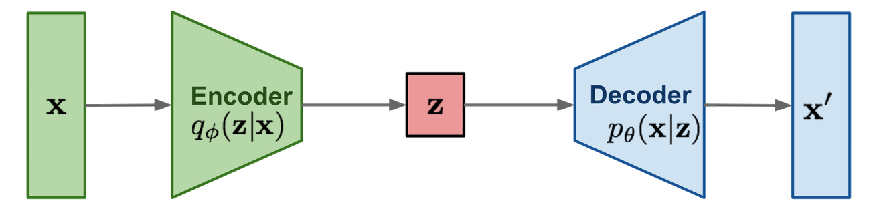
2 - Variational Autoencoders
What is the point of generating an output that is the same as input?
Rather than the output, constructed vector in the middle is important. Because it is a representation of input data and it is in a form that computer can understands. This vector itself has limited use but it can be fed into complex architectures to solve some problems.
8

Slide 10
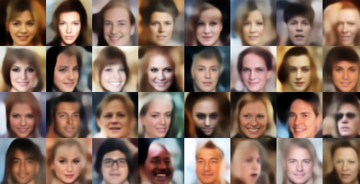
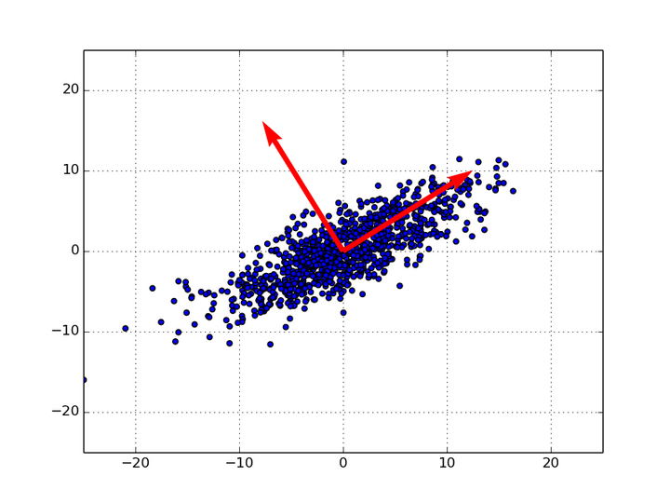
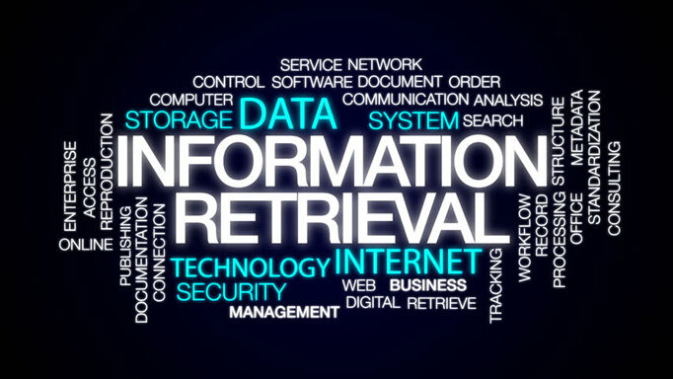
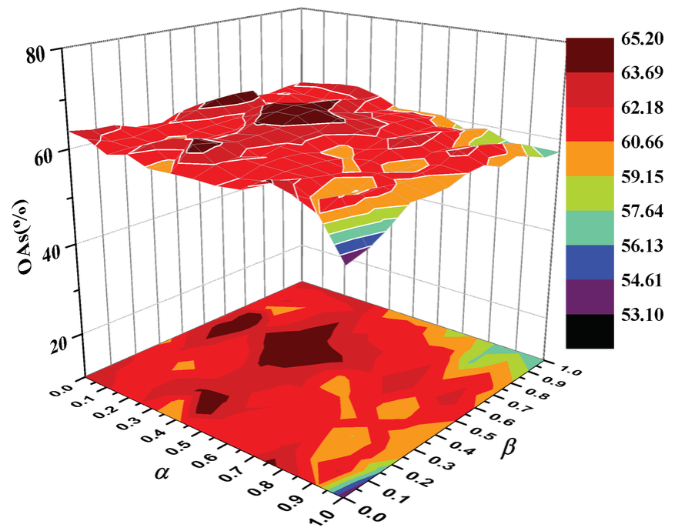
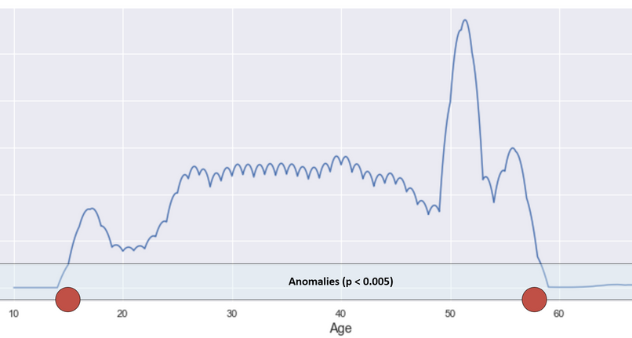
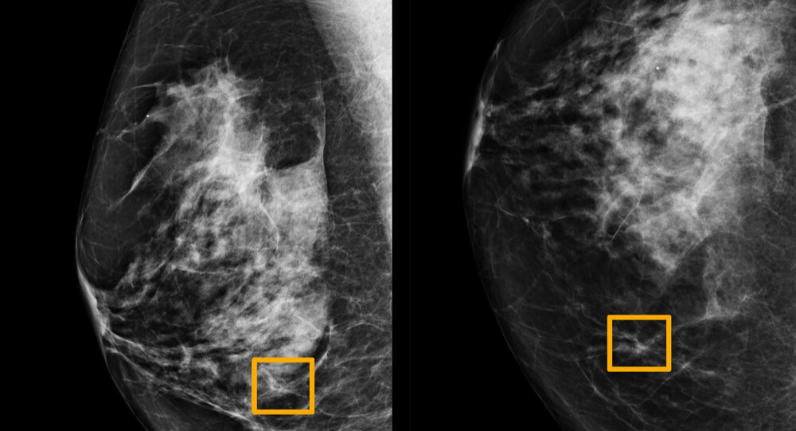
VAEs in Application
Relationships with PCA
Information Retrieval
Face Generation
Dimensionality Reduction
Anomaly Detection
Image Processing
Notes:
principal component analysis (PCA)
parenchyma (cancerous tissue)

Slide 11
3 - Comparison
VAEs learn a given distribution comparing its input to its output, this is good for learning hidden representations of data, but is bad for generating new data. This is mainly because we learn an averaged representation of the data thus the output becomes blurry.
Generated faces by VAEs
10

Slide 12
3 - Comparison
GANs take an entirely different approach. They use Discriminator to measure the distance between the generated and the real data.
It returns a number between 0 and 1. The generators goal then is learning to convince the Discriminator into believing it is generating real data.
Imaginary celebrity that generated by StyleGAN
11

Slide 13
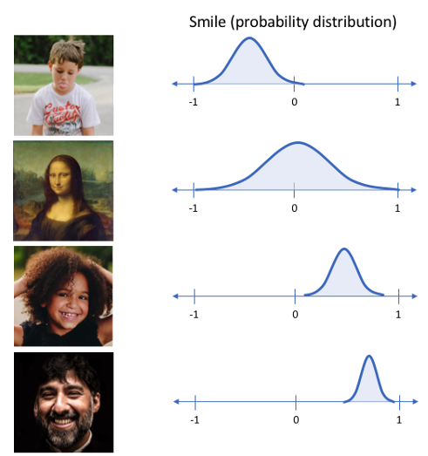
3 - Comparison
To generate random new outputs and explore the variations on data, VAEs work better GANs. Because VAEs stores latent attributes as probability distributions. Feature values are Gaussian distributed. While creating new sample, these features can be specialized.
VAEs stores latent attributes as probability distributions
12

Slide 14
3 - Comparison
The most salient difference is that, if relying on standard backpropagation, VAEs cannot have discrete variables at the input of the generator because latent attributes are Gaussian distributed, while GANs cannot have discrete variables at the output of the generator.
13

Slide 15
3 - Comparison
GANs require ﬁnding a ”Nash Equilibrium” during training. That is a point in the game where set to terminate. However there is no concrete algorithm to determine this equilibrium end of game point yet. On the other hand VAEs offer a closed form objective. There is a formula that can be used to determine the end of training phase in VAEs.
14

Slide 16
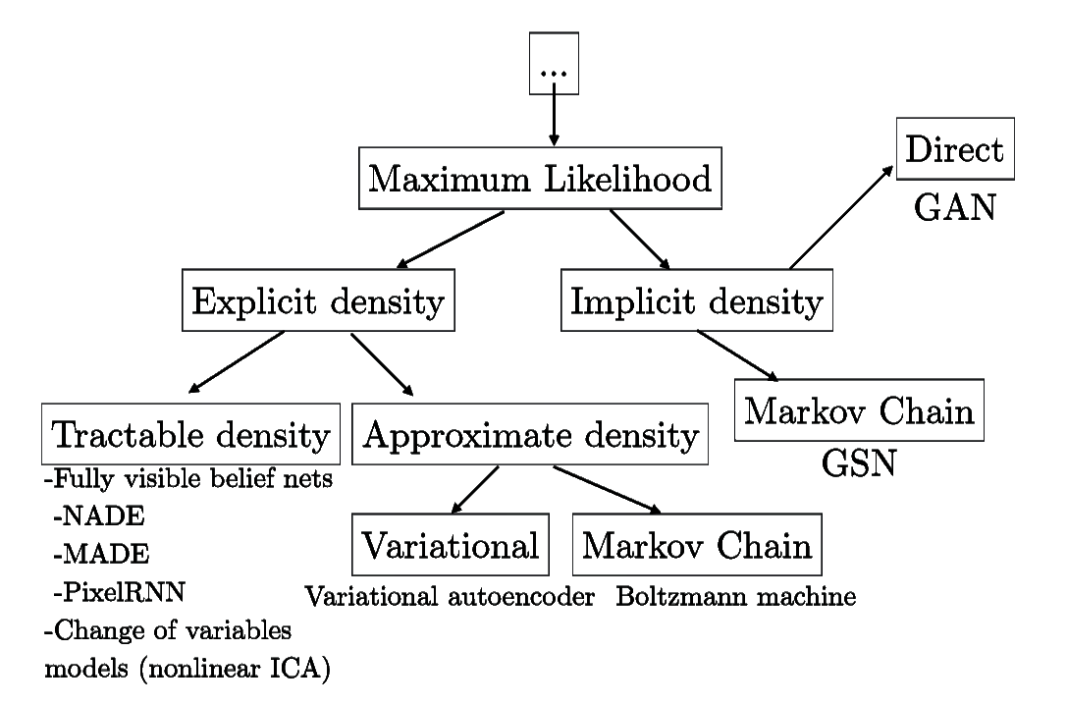
3 - Comparison
In explicit model, the task is to learn probability distribution underlying the data explicitly.
Implicit generative models learn data distribution without explicitly defines a density function.
15
Notes:
sub-branch

Slide 17
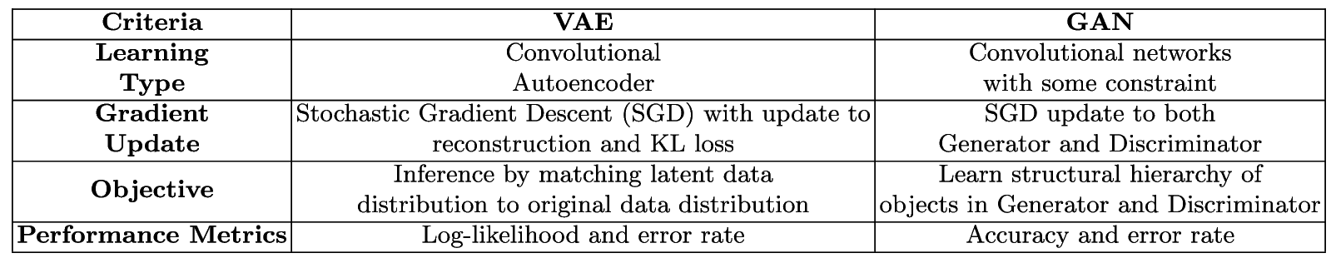
3 - Comparison
16
Notes:
table or chart

Slide 18
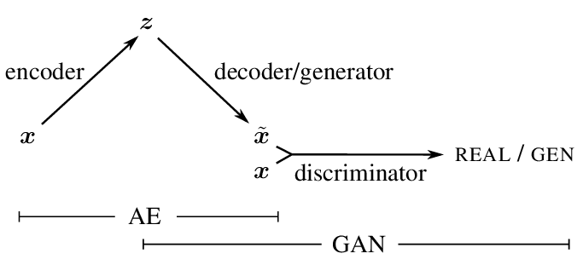
4 - VAE - GAN
It looks like a VAE, the difference is that the decoder is replaced with the generator of the GAN and loss function is calculated using the discriminator. The motivation behind this modiﬁcation is VAEs tend to produce blurry outputs. This blurriness is related to VAE's loss function.
17

Slide 19
Summary
This presentation provides a comparative analysis of two popular Generative models on basis of their objective, performance and architecture. Both models have their own strengths and weaknesses. GANs and VAEs are both learn a given data distribution rather than density, but their processes are different. Because of these differences, they can be used in different task.
18

Slide 20
Thank You For Attention !
Any Questions ?
Altar Tosun
University of Kassel

Slide 21
Summary of GANs
Main idea: minimax two-player game of two neural networks.
We train two models: generative model and discriminative model D.
G, generates some input sample for model D.
D is trying to distinguish samples from the training data and samples generated by model G.
The goal of model G is to maximize the probability of model D making a mistake.
Model G
Model G input: some noise z.
output: input sample for model D.
Model D
D input: sample from training data.
output: the probability that a sample came from the training data rather than model G.

Slide 22
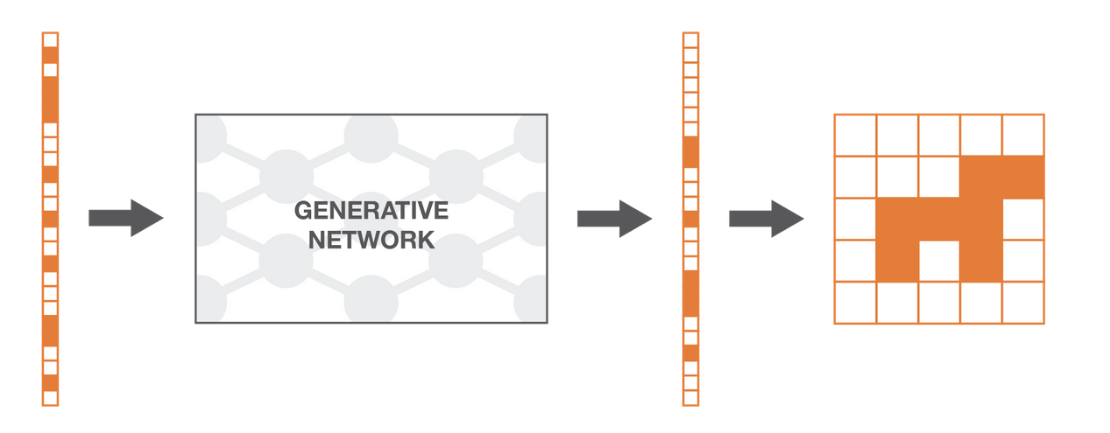
1.1 - The Generator
Model
The generator model takes a ﬁxed-length random vector as input and generates a sample in the domain. The vector is drawn randomly from a Gaussian distribution, and the vector is used to seed the generative process. After training, points in this multidimensional vector space will correspond to points in the problem domain, forming a compressed representation of the data distribution.

Slide 23
1.1 - The Generator
Model
This vector space is referred to as a latent space, or a vector space comprised of latent variables.Usually refered latent variables or a latent ﬁeld as a reﬂection or compression of a data distribution. That is, a latent space provides compression or higher-level concepts of observed raw data such as input data distribution.
In GANs, the generator model applies meaning to points in a selected hidden area; such that new points drawn from the hidden area can be input to the generator model as input and used to produce new and diﬀerent output samples.

Slide 24
1.2 - The Discrimator
Model
The discriminator model takes an example from the domain as input (real or generated) and predicts a binary class label of real or generated fake. The real example comes from the training dataset. The generated examples are output by the generator model. The discriminator is a classiﬁcation model. After the training process, the discriminator model is discarded as we are interested in the generator. Sometimes, the generator can be repurposed as it has learned to eﬀectively extract features from examples in the problem domain. Some or all of the feature extraction layers can be used in transfer learning applications using the same or similar input data.

Slide 25
1. 3 - Two - Players
Game
The two models, the generator and discriminator, are trained mutually. The discriminator is then updated to get better in discriminating real and fake samples in the next round. The generator is updated, based on the generated samples fooled the discriminator. In this way, the two models are competing against each other. In this case they are playing a zero - sum game. That means: when the generator fools the discriminator, it is rewarded, or no change is needed to the model parameters (weights), but the discriminator is penalized and its model parameters are updated.

Slide 26
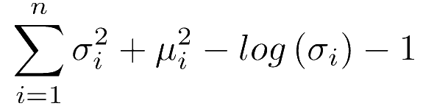
2 .1 - Kullback-Leibler Divergence
Encodings should be as close as possible to each other, allowing smooth interpolation and enabling the production of new samples.
There is a Kullback-Leibler divergence in the loss function. Kullback–Leibler divergence (also called relative entropy) is a measure of how one probability distribution is diﬀerent from a second, reference probability distribution.
For VAEs, KL loss is:

Slide 27
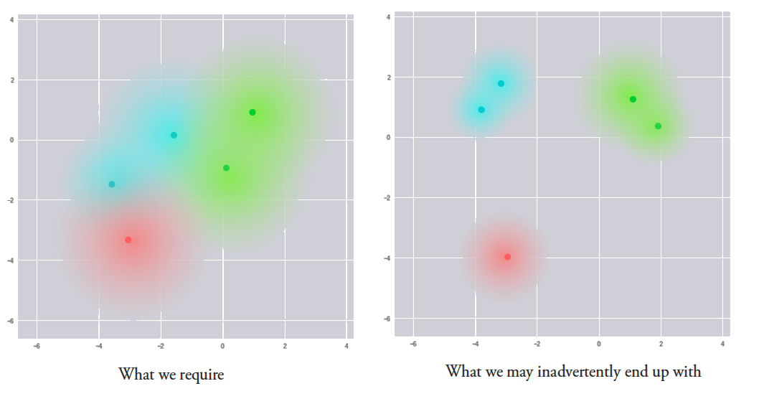
2 .1 - Kullback - Leibler Divergence
Intuitively, this loss helps the encoder to distrubute all encodings around the center of the latent space.
If it tries to cluster them away from the origin, it will be penalized.

Slide 28
BigGAN
This is the latest development in GANs for image generation.For the ﬁrst time, GANs have generated images with high ﬁdelity and low variety gap. Previous highest Inception Score (visual quality of generated images) was 52.52 and BigGAN achieved an Inception Score of 166.3, which was 100% better.

Slide 29
StyleGAN
GANs research. StyleGAN was introduced by Nvidia. StyleGAN sets a new record in Face generation tasks. Apart from generating faces, it can generate high-quality images of cars, bedrooms etc.

Slide 30
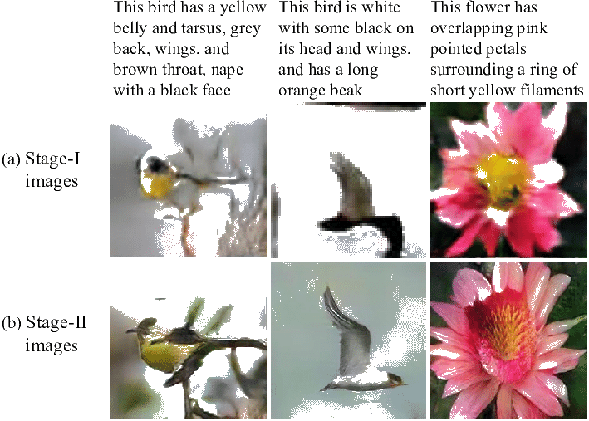
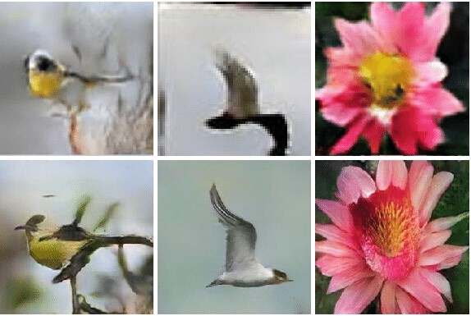
StackGAN
The deﬁnition of a StackGAN is text to Photo-Realistic Image Synthesis with Stacked Generative Adversarial Networks. A StackGAN is a pair of networks that generates realistic looking images when provided with a text description.

Slide 31
CycleGAN
CycleGANs have some use-cases, such as converting photos to paintings, converting a picture taken in summer to a photo taken in winter, or converting pictures of horses to pictures of zebras.

Slide 32
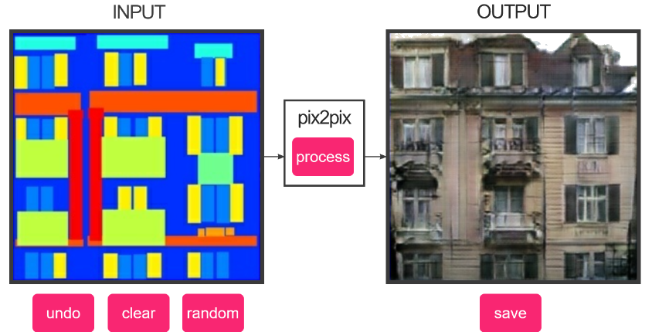
Pix2Pix
Converting night images to day images, colorizing black and white images, translating sketches to photos and many more.

Slide 33
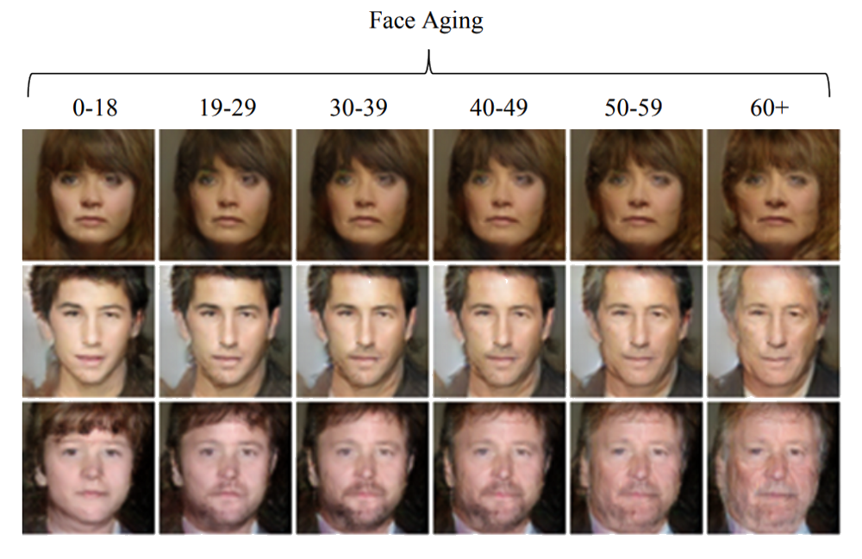
Age - cGAN
Face aging has many industry use cases, including cross-age face recognition, ﬁnding lost children, and in entertainment and this is what Age-cGAN does.

Slide 34
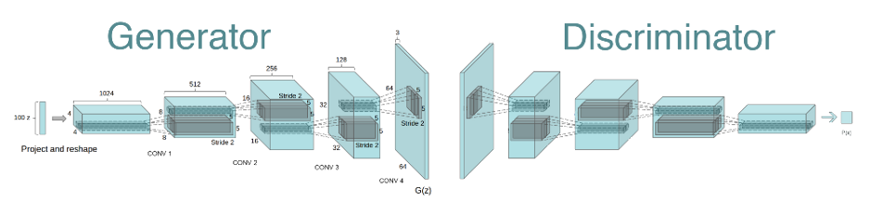
DCGAN ( Deep Convolutional GANs)
CNNs have been used the ﬁrst time within GANs and achieved impressive results. It was a major milestone in GANs research as it introduced major architectural changes to tackle problems. Since then, numerous GAN architectures were introduced based on the architecture of DCGAN.

